Slide 1

Artificial Illusion
The Art of Deepfake Technology

Slide 2
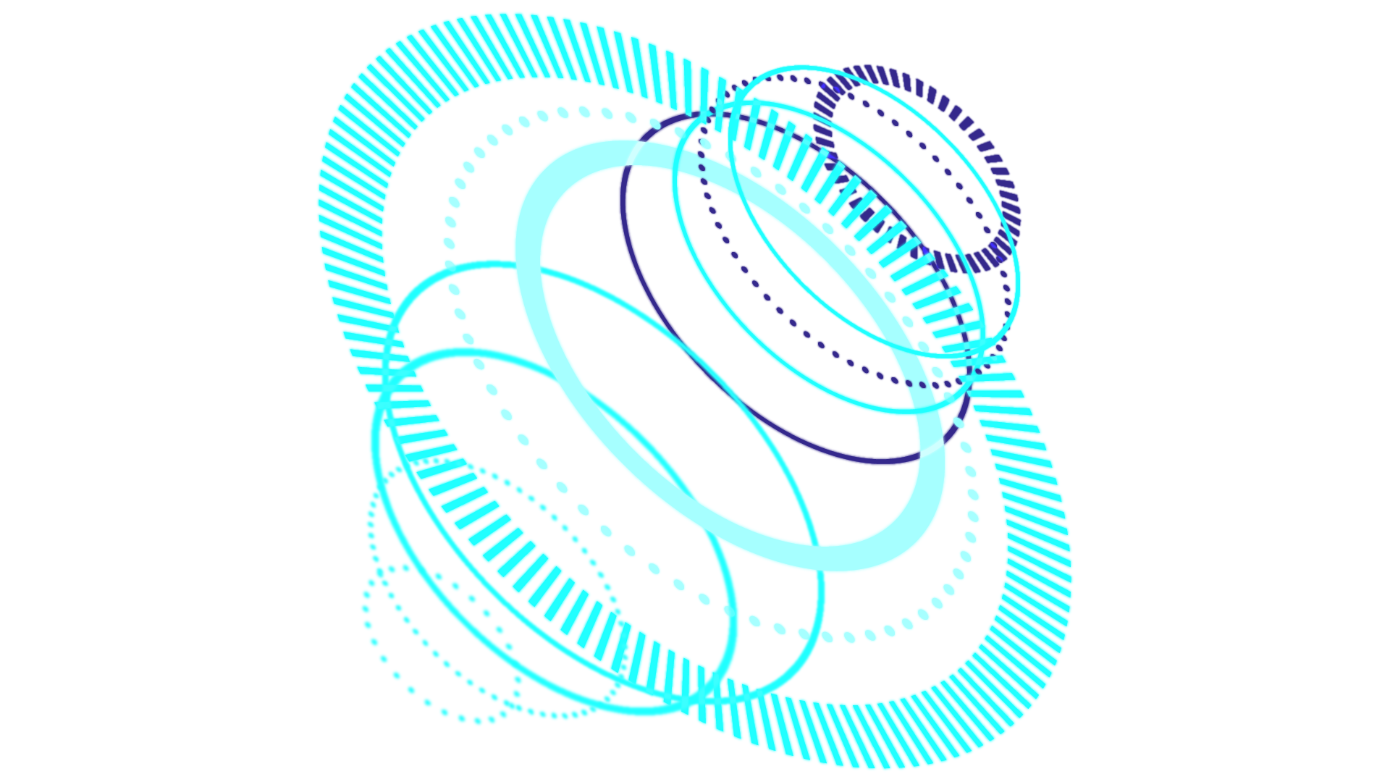
TABLE OF CONTENTS
01
Introduction
02
Implement & challenge
03
Training Results
04
Implementation Results and Benchmarking

Slide 3


INTRODUCTION

Slide 4

Type
Deepfake
Model
MesoNet
Objectives
Enhance,Modify,Generalize

Slide 5
Limitations
Resources,Time, References
Gaps
Missing Parts in the Base-Model

Slide 6
Implemntation and Challenges

Slide 7

Implementations
Evaluation
Data Collection
Preprocessing
Training
Self-Gathered
FaceForensics++
Deep Fake Detection Challenge
Original Dataset
Loss
Accuracy
Classification Report
Confusion Matrix
Real World effectiveness
Epochs 60 – 80 ~ 100
Batches 16 – 32 - 64
Learn Rate 0.001
Decay Weight 1e-5

Slide 8
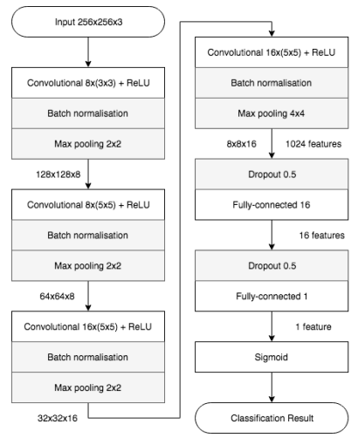
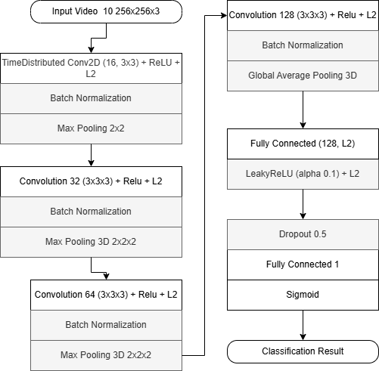
Base-line model
Refined Model
Model Structure

Slide 9
Computation Load
Incomplete Training
Unclear Output
Challenges
Took an average of 2 ~ 8 hours to preprocess videos for small dataset size
Took an average of 1 ~ 2 hours to preprocess images
The Training code was missing from the base-line
Searching & developing the base-line train code
The base-line output was unclear

Slide 10
Base-Dataset
Incompatible videos
Errors
Challenges
The Base-line dataset source initially wasn’t available
The results wasn’t that of a good compatibility to videos
Some minor and major error appear after long time of running

Slide 11
Training Results

Slide 12

Training Datasets Roadmap
Meso4 (Enhanced version)
Original DeepFake Dataset (image-based)
Meso-Inception4 (Enhanced version)
Original DeepFake Dataset (image-based)
Meso3D (Integrated version)
FaceForensics++ DeepFake-based videos Dataset

Slide 13

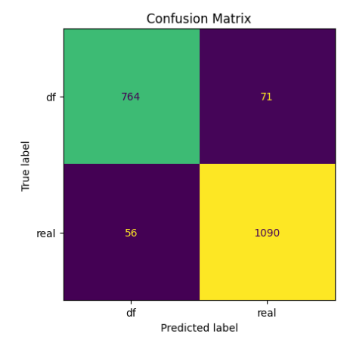
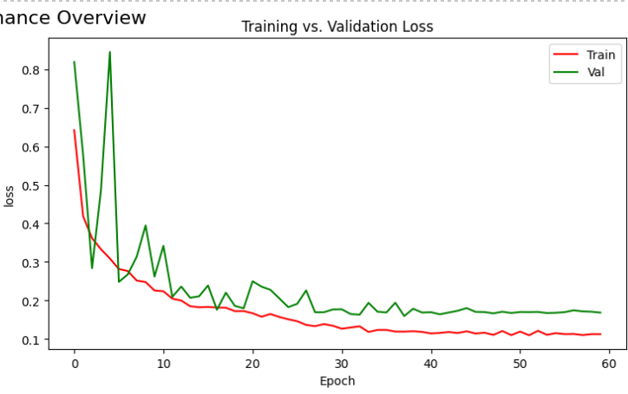
Meso-4 Refined
Validation Accuracy = 93.50% Test Accuracy = 92.41%

Slide 14
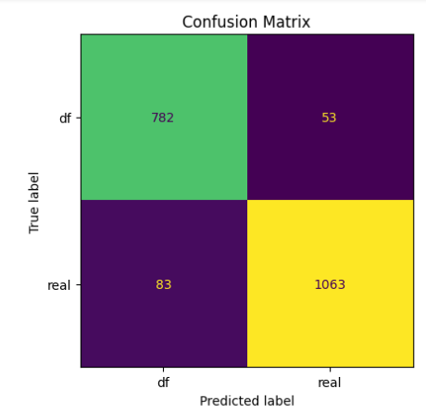
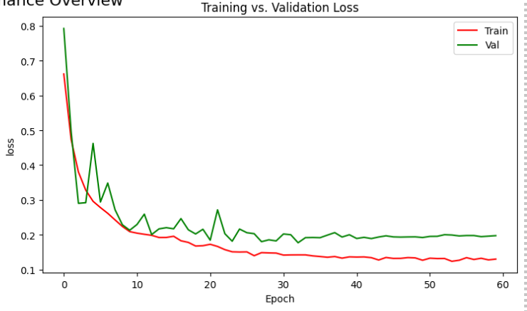
MesoInception-4 Refined
Validation Accuracy = 93.13% Test Accuracy = 94.1%

Slide 15
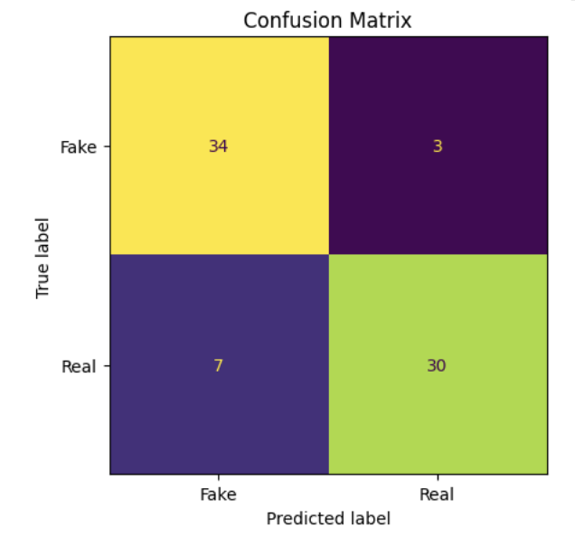
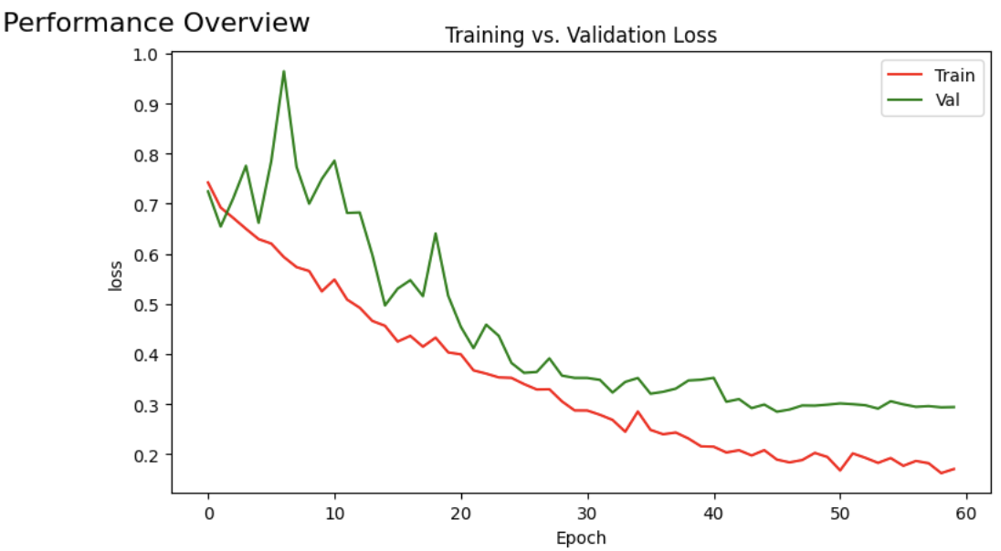
Meso-3D
Validation Accuracy = 86.49% Test Accuracy = 82.89%
Notes:
Training on 300 videos (because of preprocessing time and resources), but with more resources we might get better results with more training videos

Slide 16
Implementation Results & Benchmarking

Slide 17
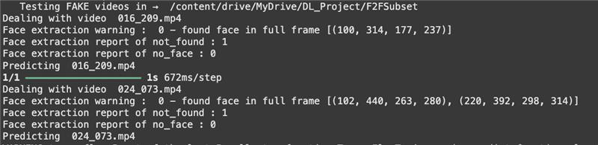
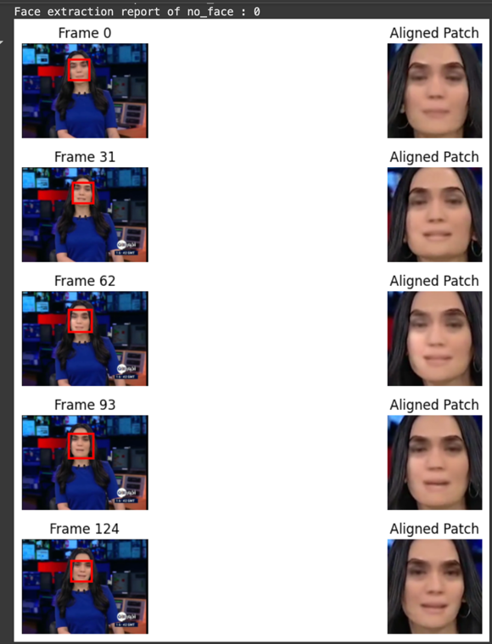
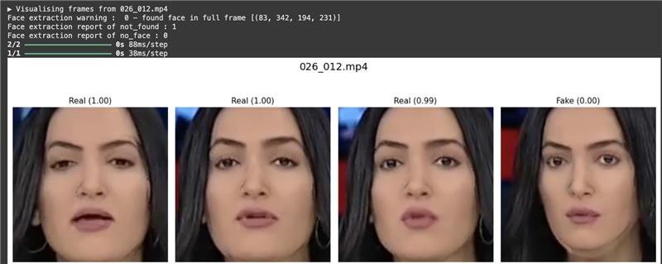
Base-line model
Refined Model
Outputs

Slide 18
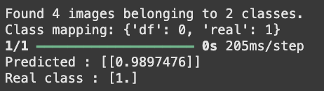
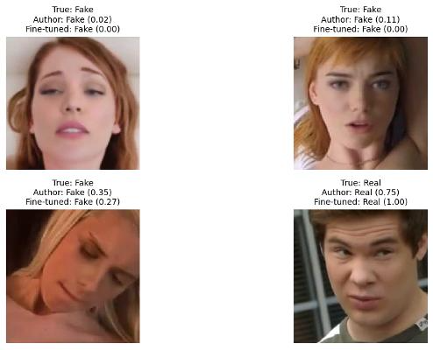

Base-line model
Refined Model
Outputs

Slide 19
Model
Comparison of Test Results on Deepfake Dataset
Loss
Accuracy
Base-Model Weights
0.086
89.4%
Fine Tuned Weights
0.057
92.4%

Slide 20
Dataset
50 Deepfake Videos Comparison
Model
Base- Model
Refine- Model
Meso-4
28%
72%
50 Deepfake Videos from FaceForensics++ Dataset
12%
64%
Meso-Inception4

Slide 21
Dataset
50 Deepfake Videos Comparison
Model
Base- Model
Refine-Model
50 Deepfake Videos from celeb-df Dataset
Meso-4
14.5%
73.5%
0.0%
48.2%
Meso-Inception4

Slide 22


Thank you for Listening
Jawaher Alkhamis
Dhoha Almubayedh

